Slide 1

Introduction to Computer Vision

Slide 2
Introduction
1
Presentation of myself, Outline and Subject

Slide 3


Welcome!
I am Tom Genlis
EPITA (2024) ING2
SCIA Major - CV Speciality
tom.genlis@gmail.com

Slide 4
SCIA Major
AI & Data Science Major at EPITA
Analysis & Optimization Maths
Deep Learning
CV & NLP
Basics to state-of-the-art algorithms and models
Data Engineering

Slide 5
Presentation Outline
Quick Intro to Machine Learning & ML Concepts
General Conference over Computer Vision
Available Workshop (Learn)
Kaggle Contest (Practice)
Feel free to ask any questions regarding this presentation !

Slide 6




Info Links
github.com/GDSC-EPITA/gdsc-computer-vision-workshop
discord.gg/3kbcZRFpbm

Slide 7
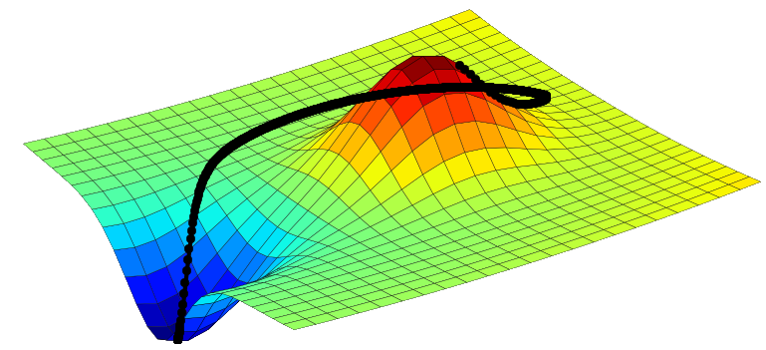
Quick Intro to Machine Learning
2
Definitions

Slide 8
Introduction Outline
What is AI ?
What is Machine Learning ?
Supervised Learning
Unsupervised Learning
Reinforcement Learning
Deep Learning
8 Core ML Concepts

Slide 9
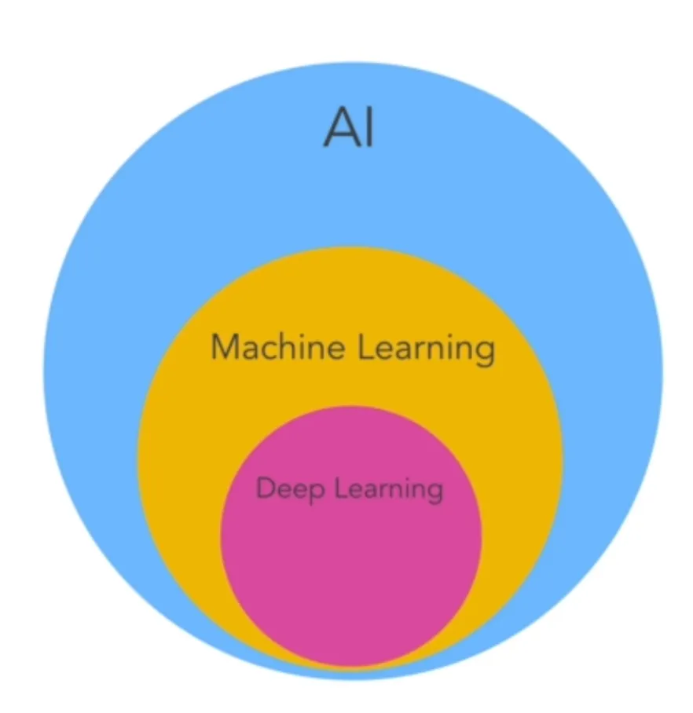
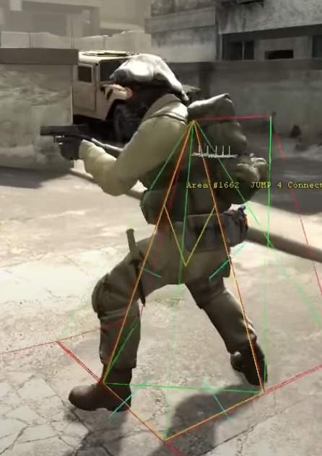
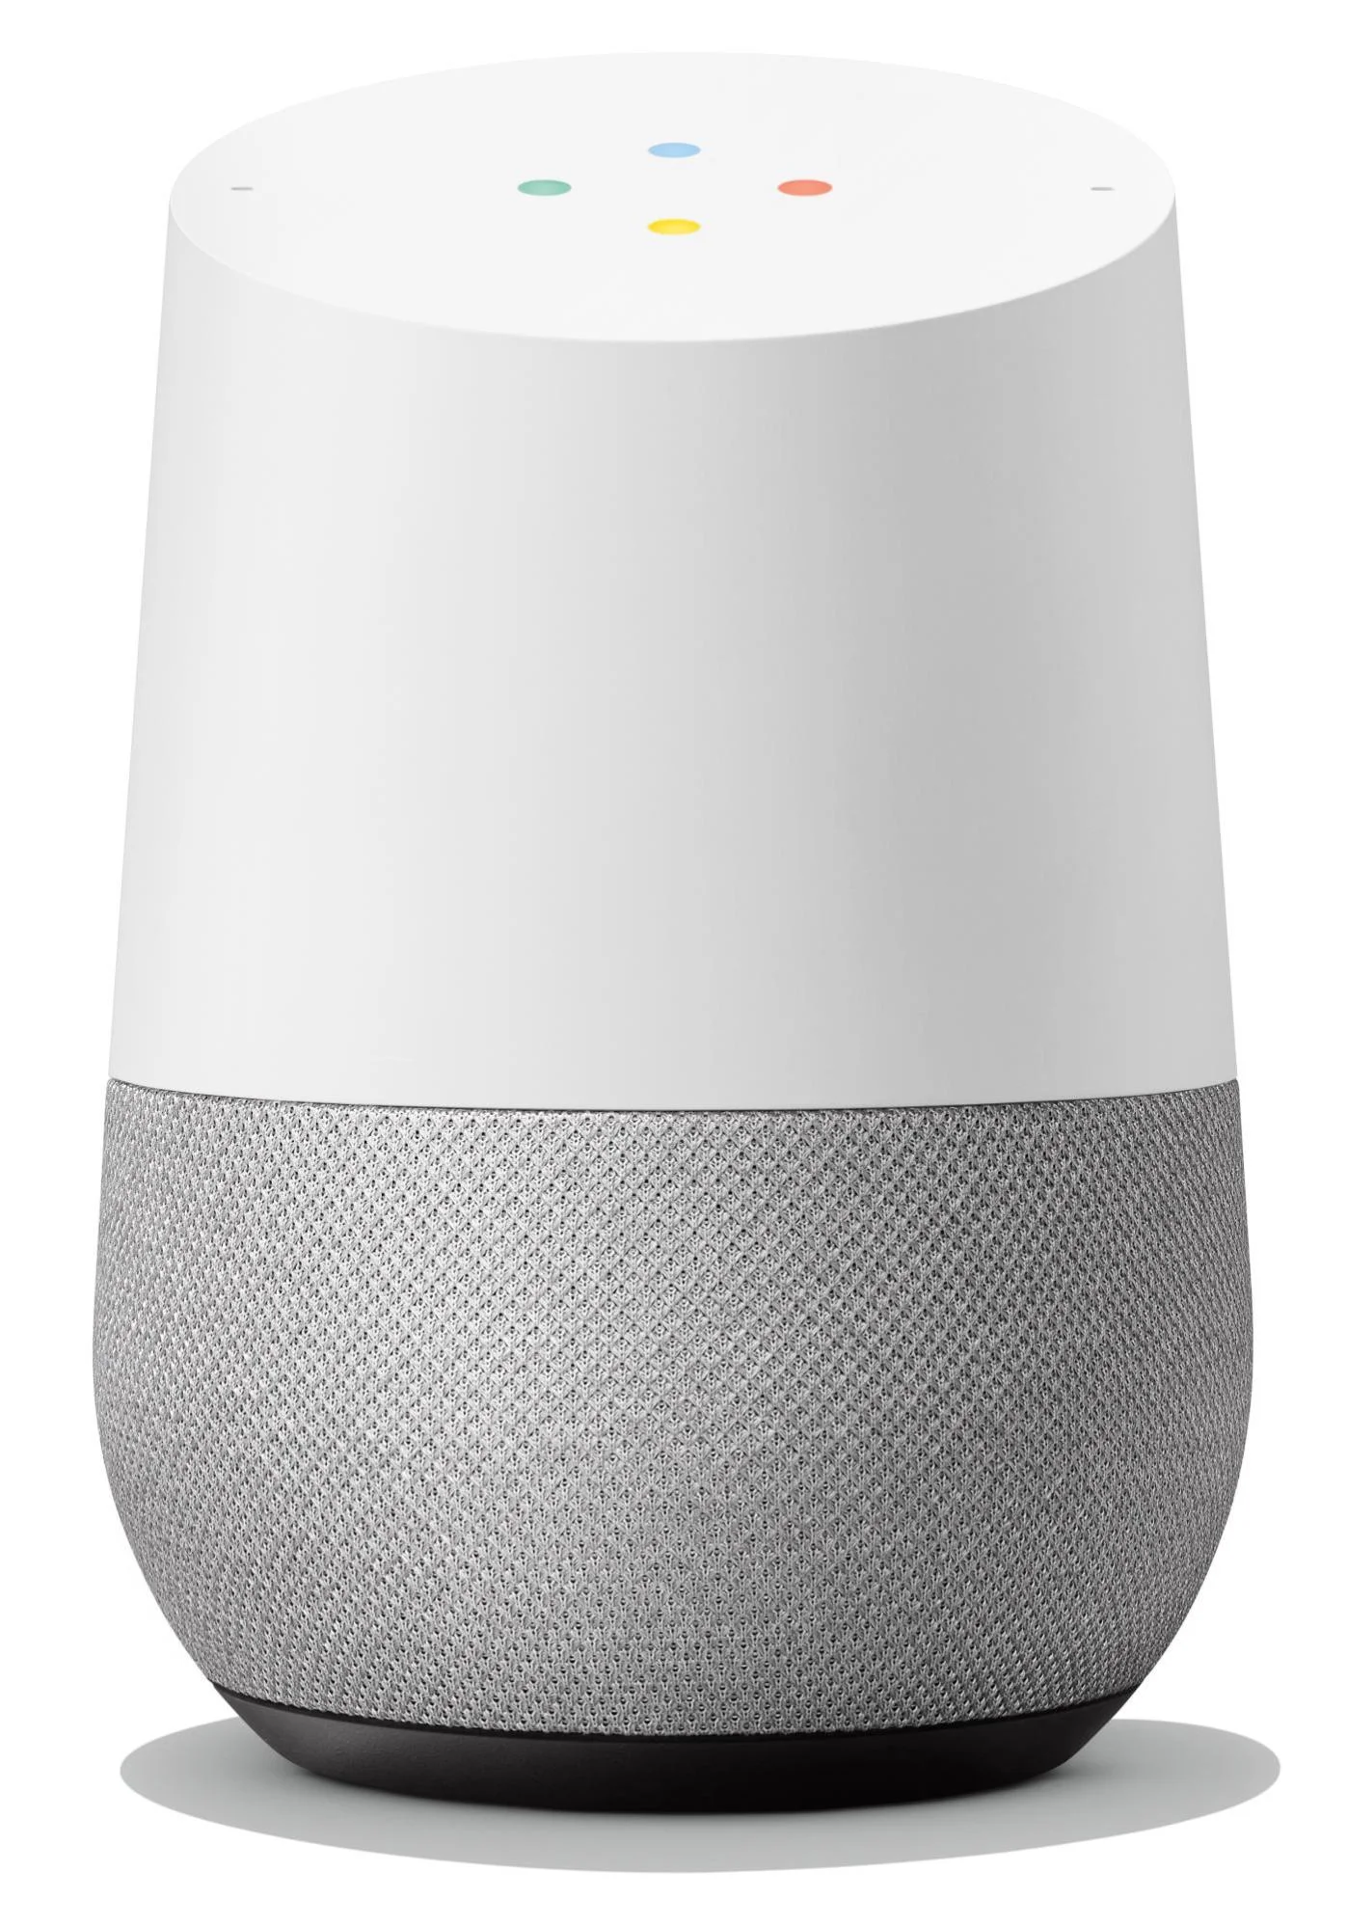
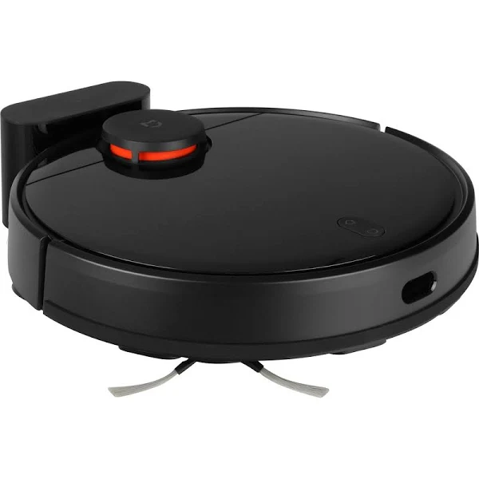
What is AI ?
Mimic Human Behavior

Slide 10
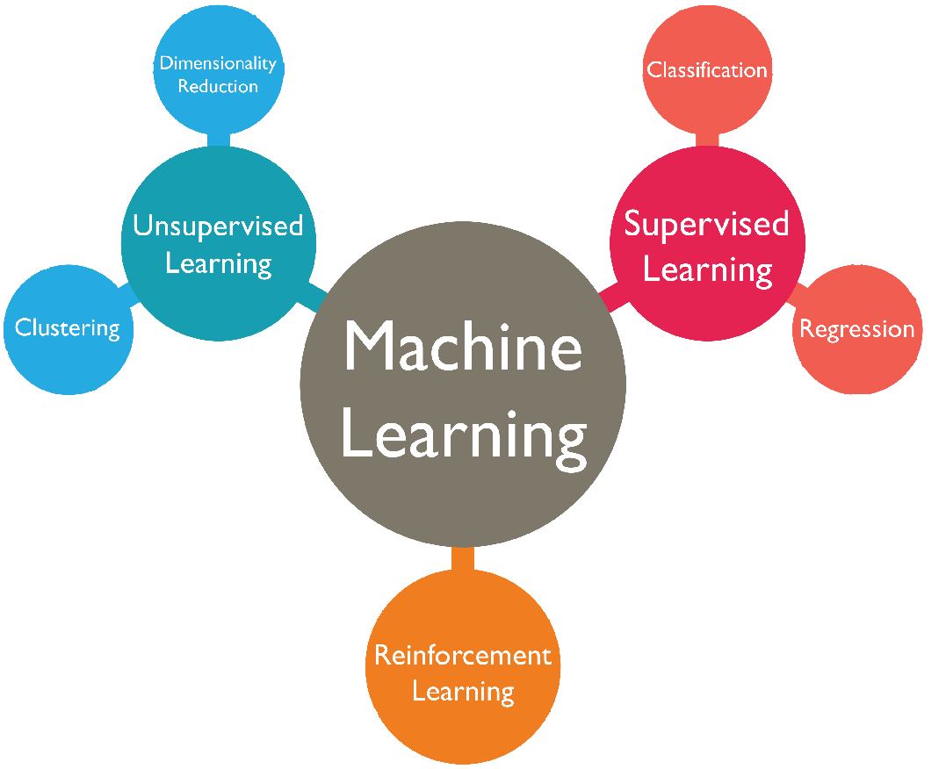
What is Machine Learning ?

Slide 11
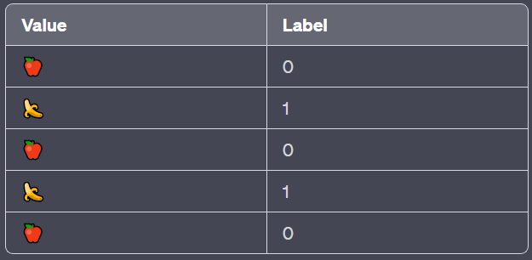
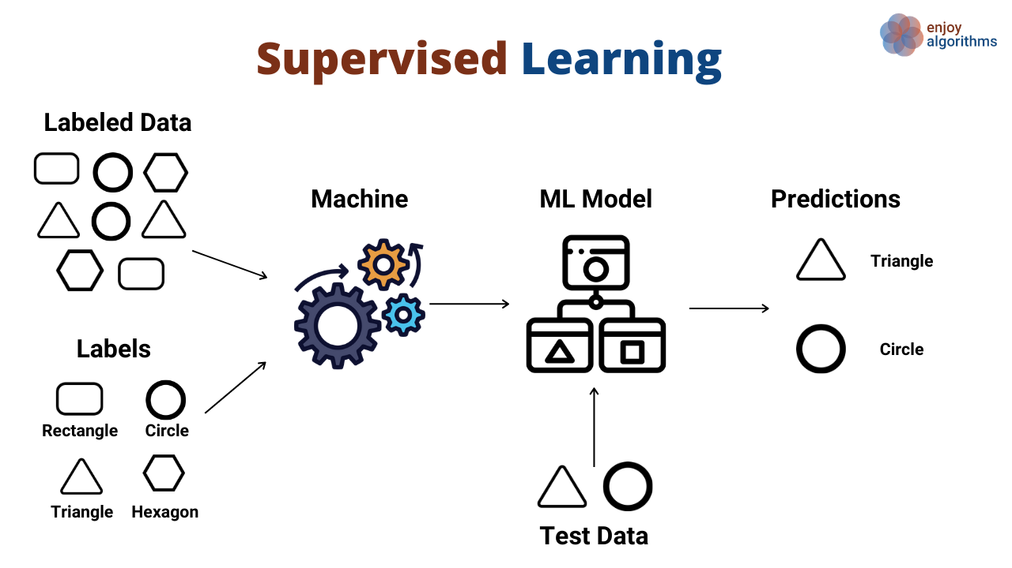
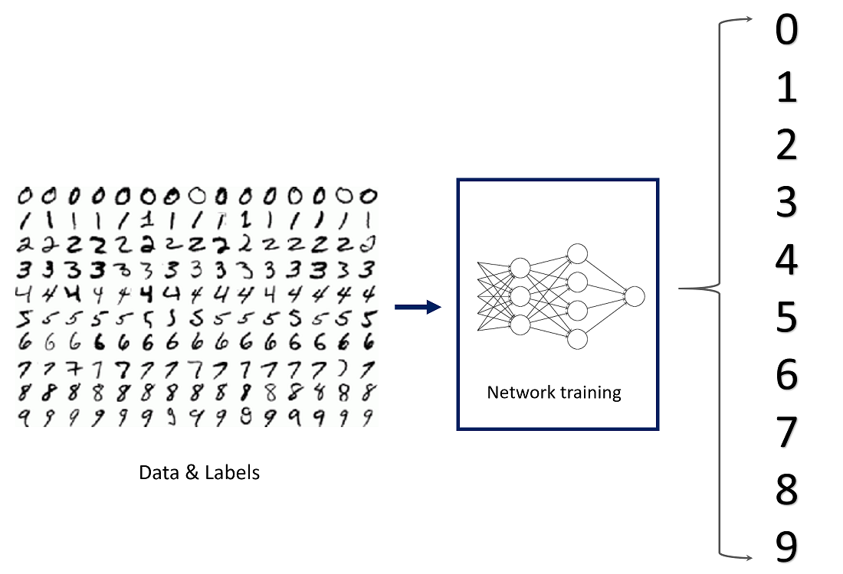
Supervised Learning

Slide 12
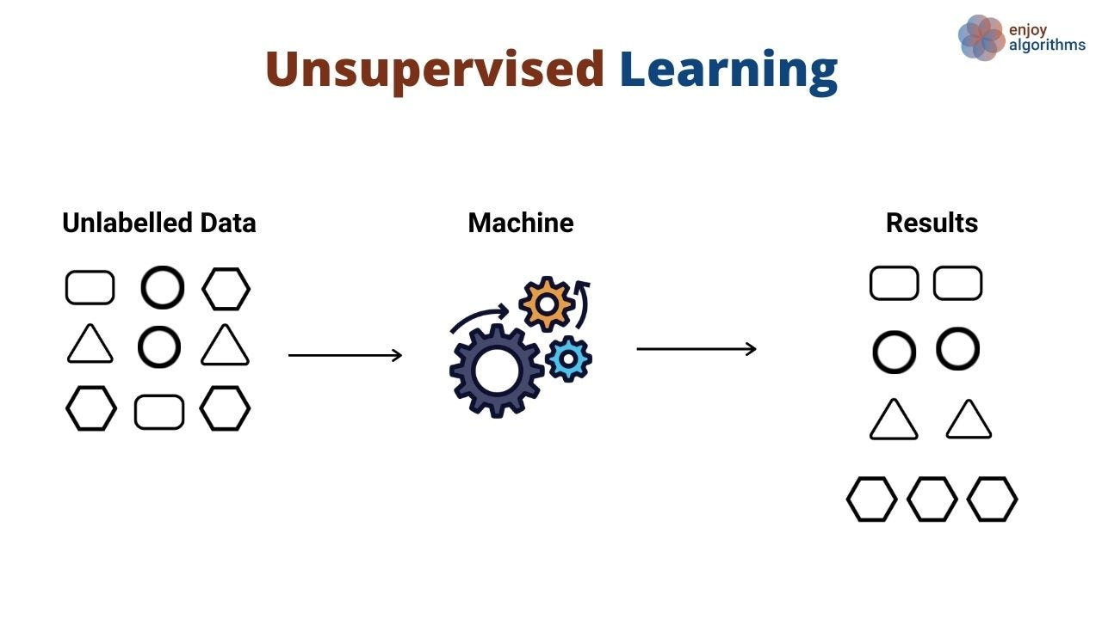
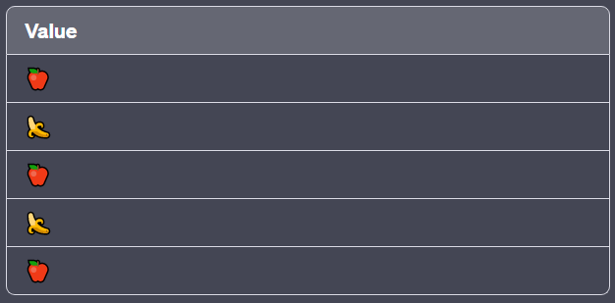
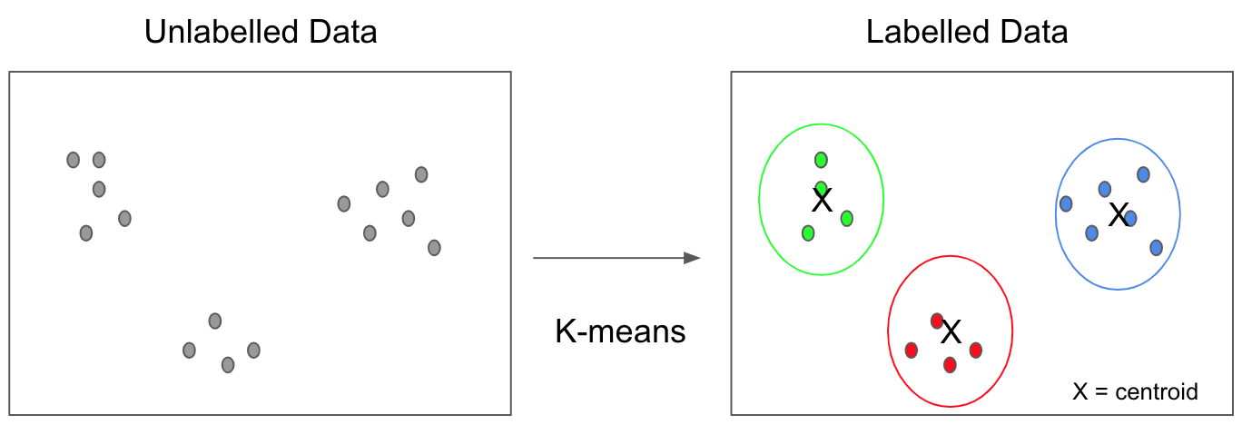
Unsupervised Learning

Slide 13
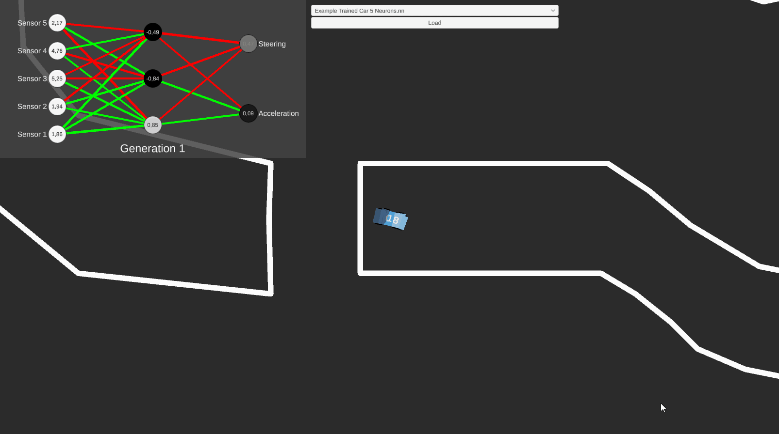
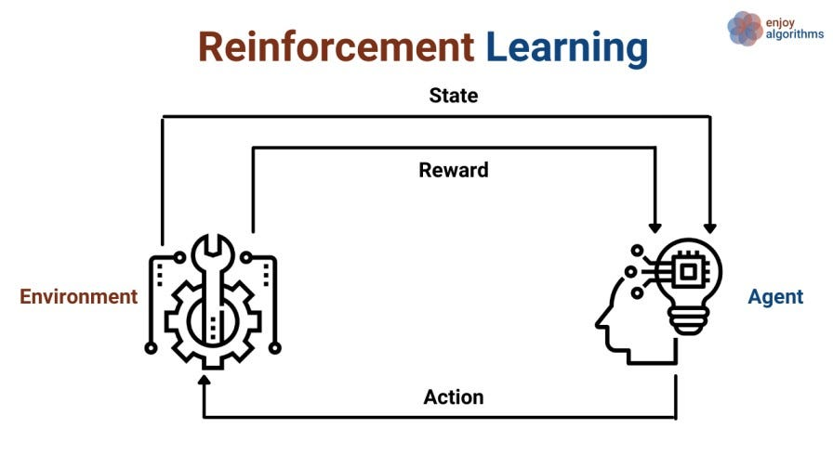
Reinforcement Learning

Slide 14
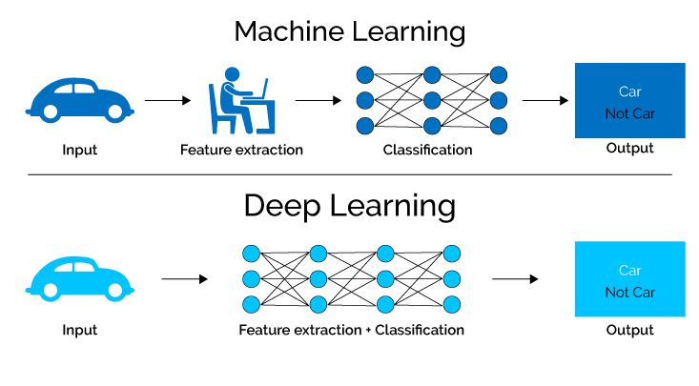
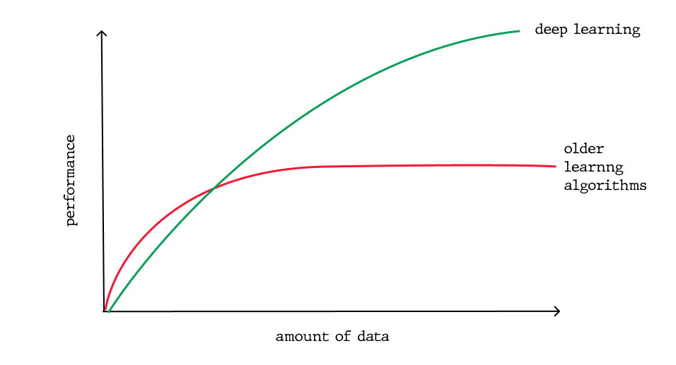
Deep Learning

Slide 15
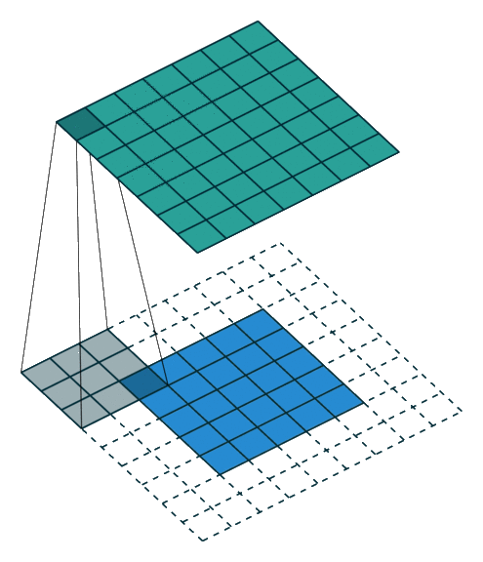
Core ML Concepts
3
Definitions, Examples

Slide 16
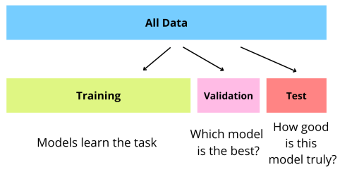
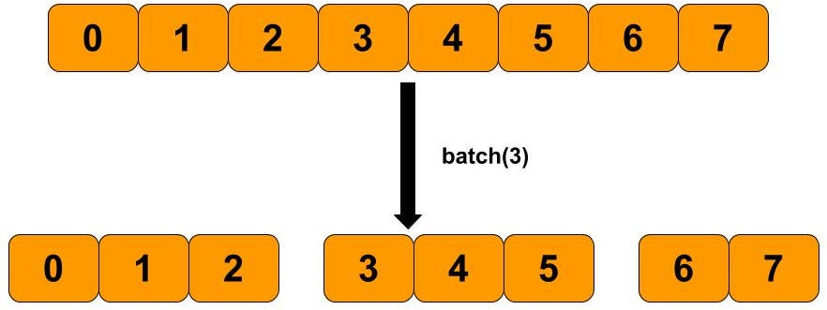
ML Concepts : Datasets & Batching

Slide 17
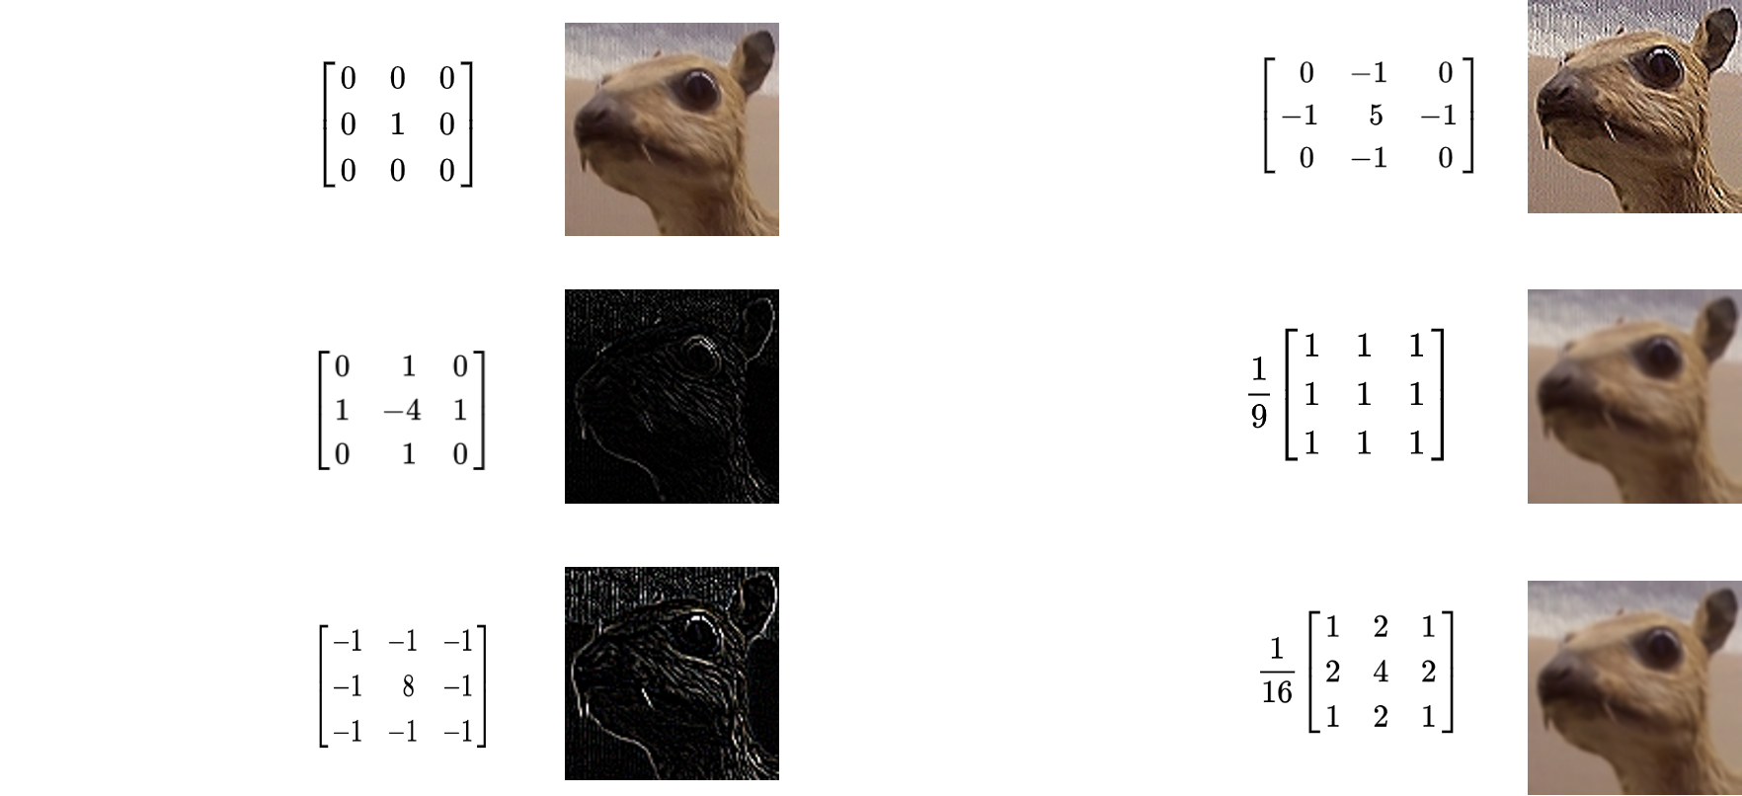
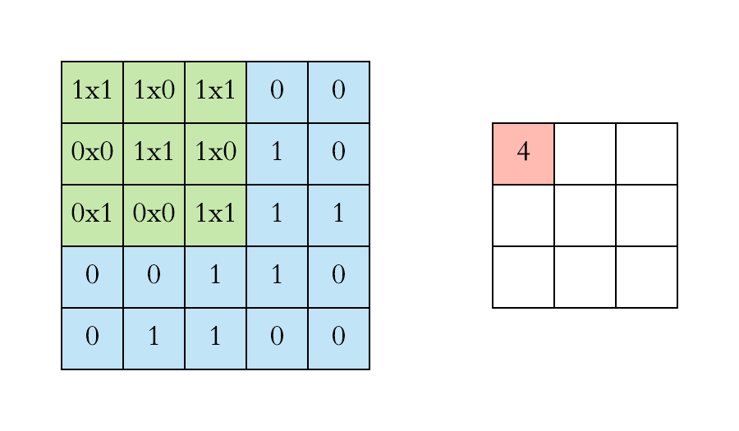
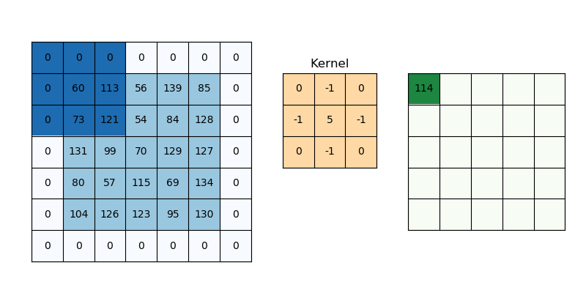
ML Concepts :
Convolutions
Kernels
Sharpen
Identity
Average
Blur
Convolution
Edge Detection
Result
GaussianBlur
Kernel size (in ex :(3, 3))
Strides (in ex : (1, 1))
Padding (in ex : none)
Spatial Context

Slide 18
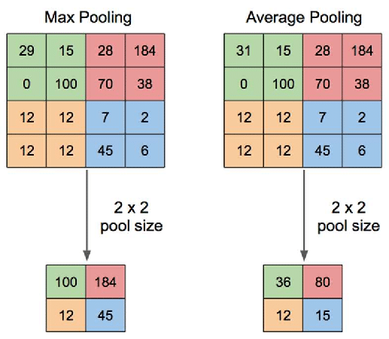
ML Concepts : Pooling

Slide 19
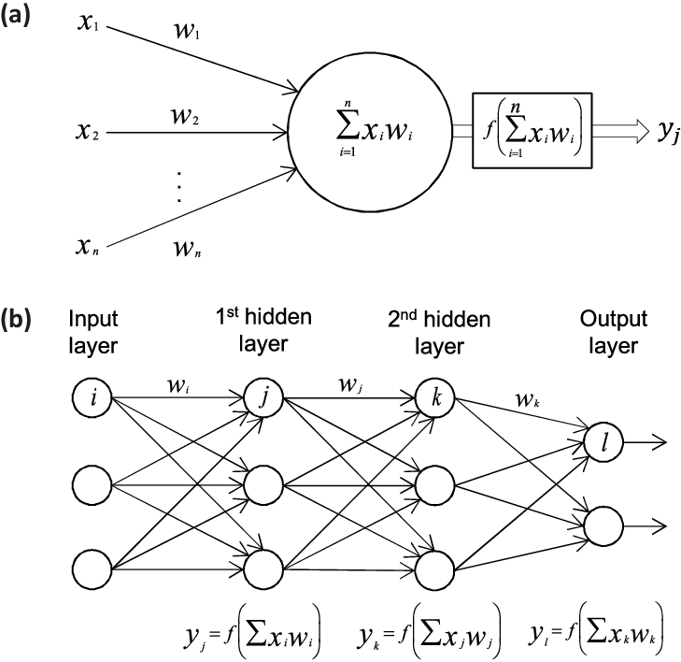
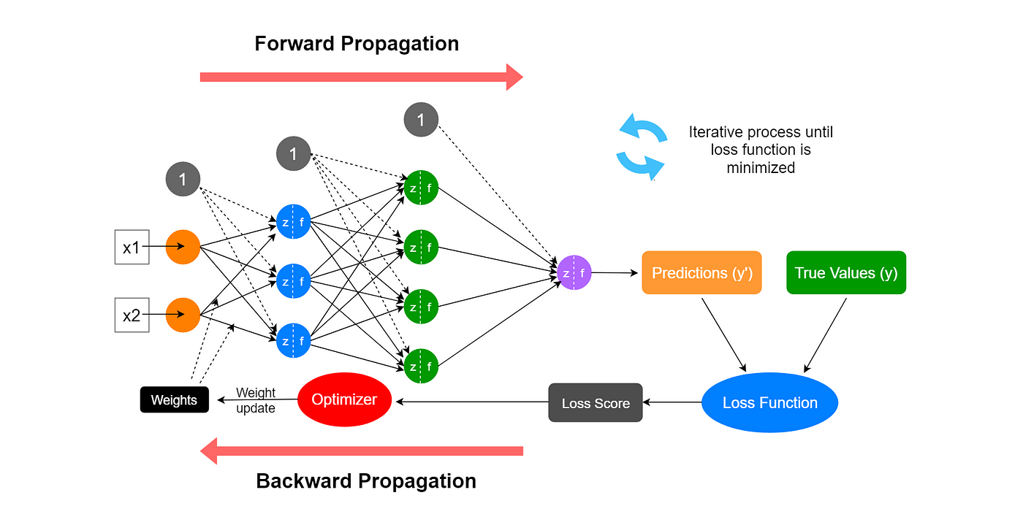

ML Concepts : Neural Networks

Slide 20
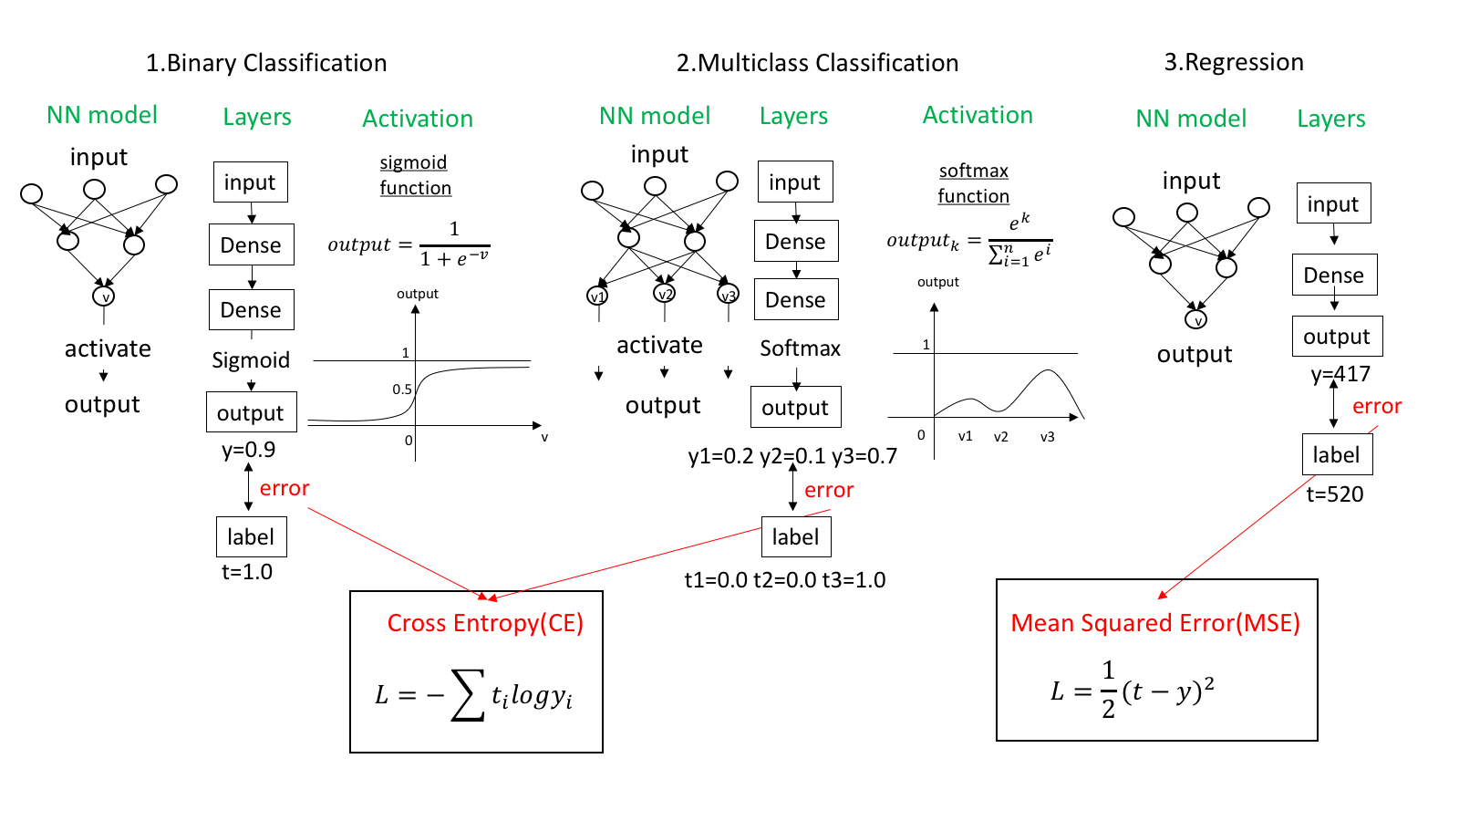
ML Concepts : Loss Function

Slide 21
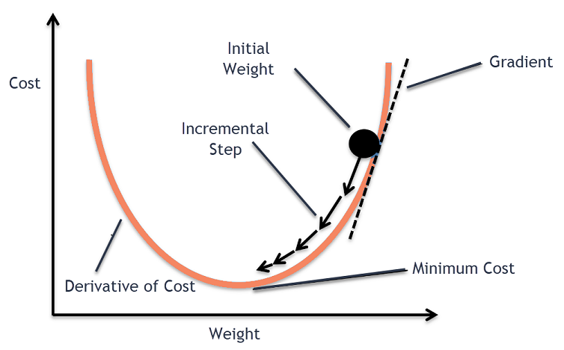
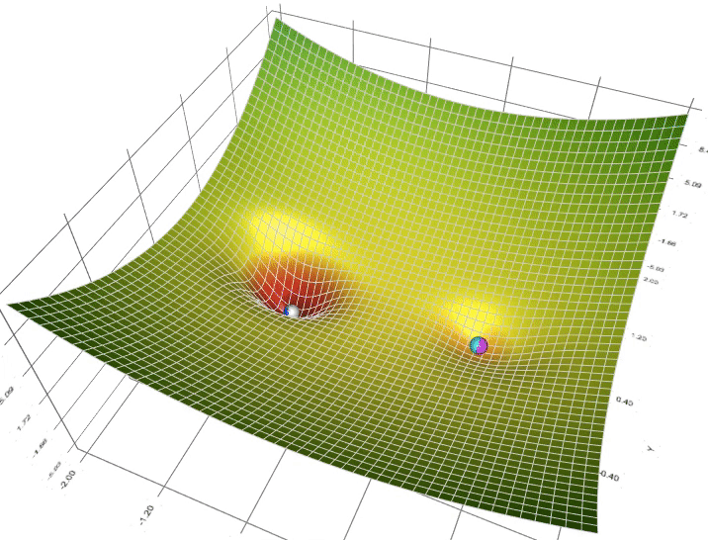
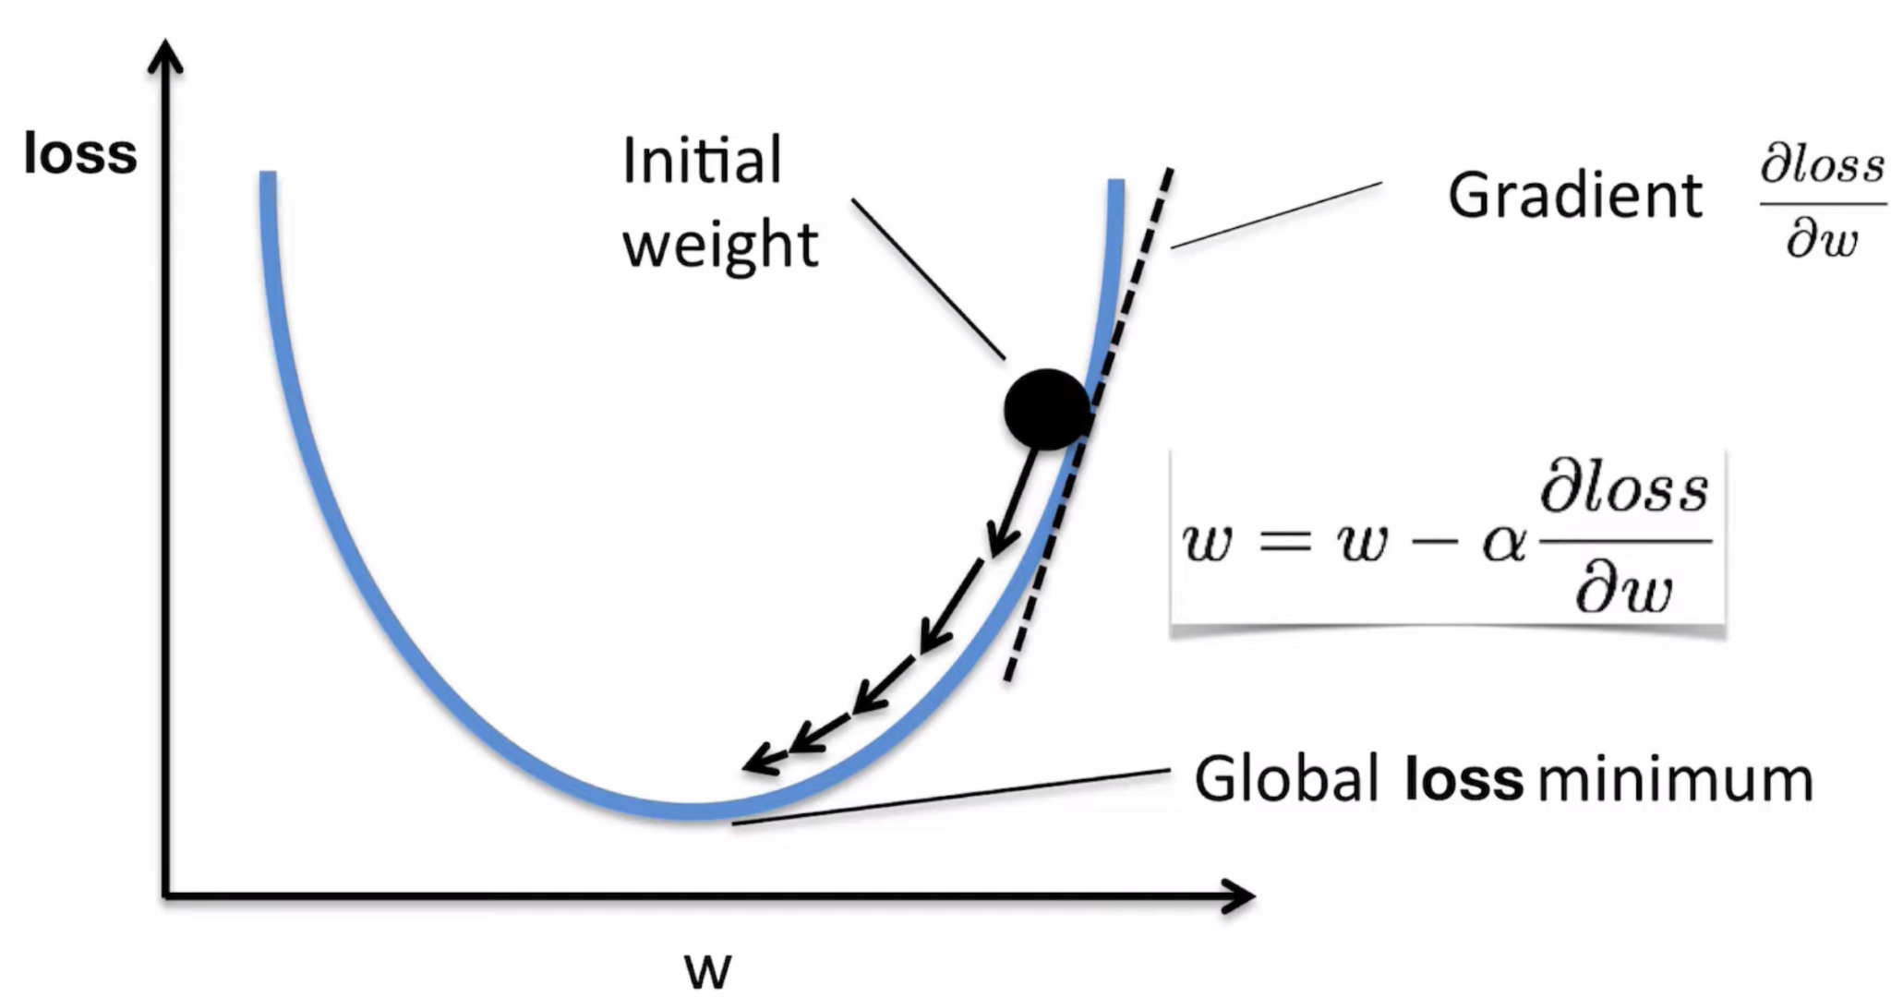
ML Concepts : Gradient Descent

Slide 22
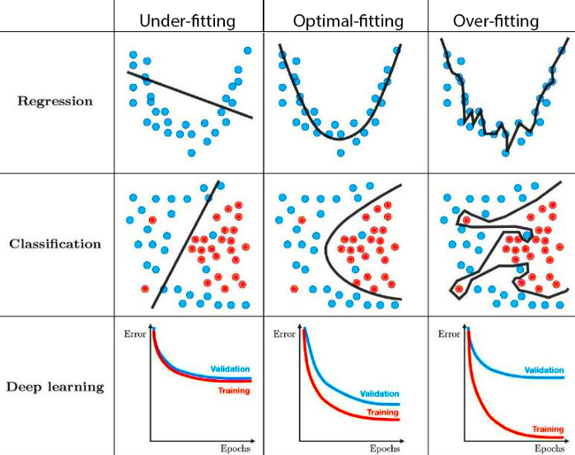
ML Concepts : Overfitting & Underfitting

Slide 23
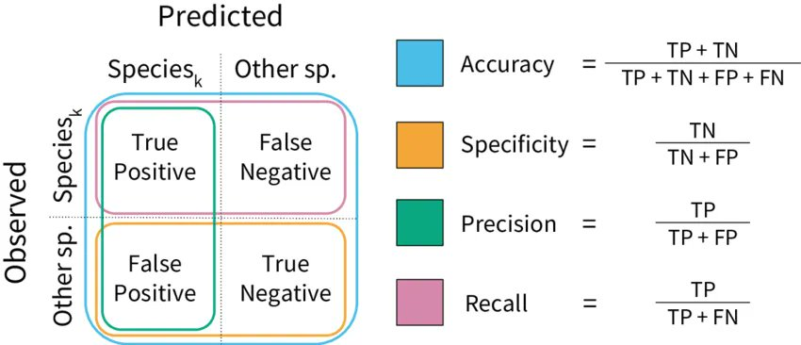
ML Concepts : Metrics

Slide 24
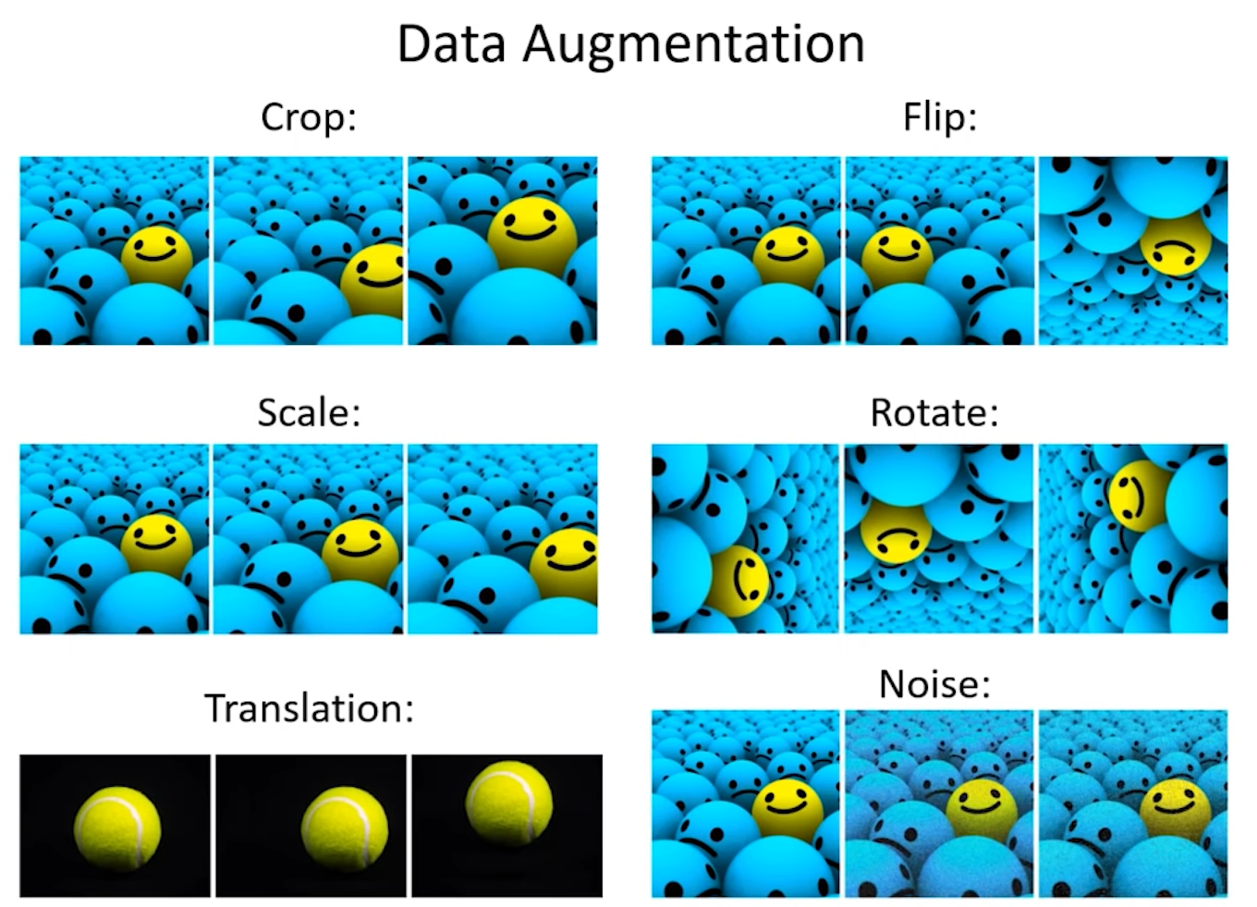
ML Concepts : Data Augmentation

Slide 25
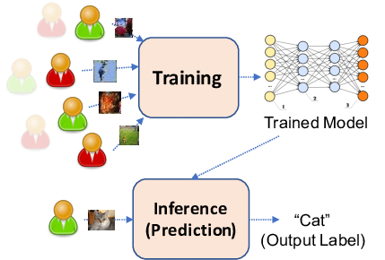
ML Concepts : Post Training Usage

Slide 26
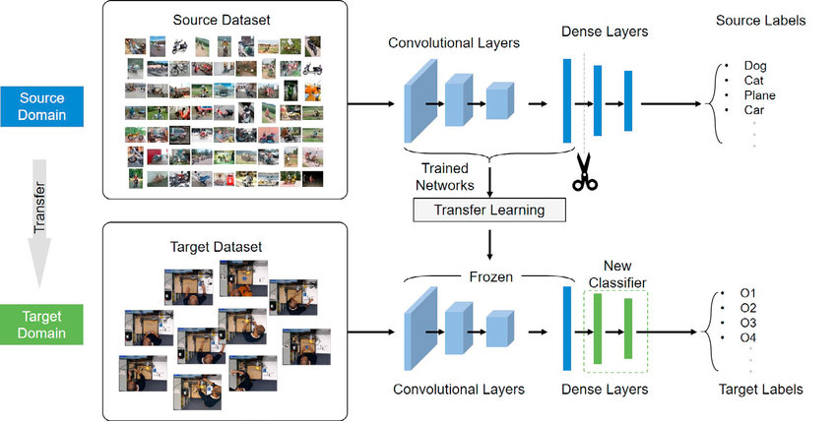
ML Concepts : Transfer Learning

Slide 27
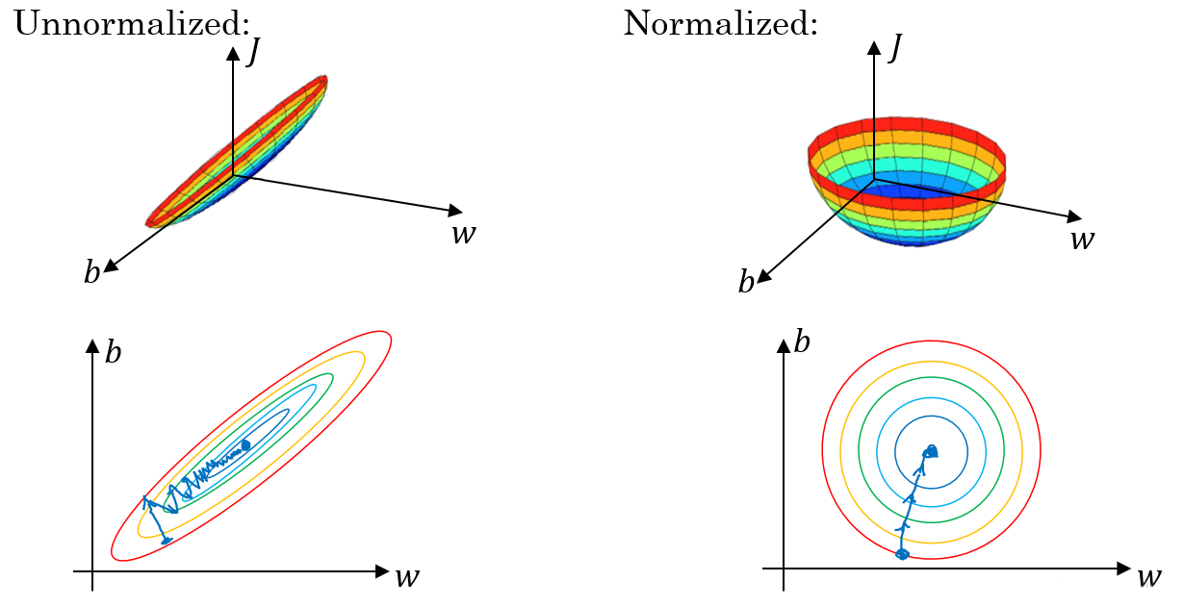
ML Concepts : Normalization

Slide 28
What is Computer Vision ?
4
Definition, Applications and Progress

Slide 29
Exploration Outline
History Of Computer Vision
Computer Vision Subfields
Classification
Localization
Object Detection
Segmentation

Slide 30
Computer Vision
Subfield of AI

Slide 31
History of Computer Vision
1963 – Larry Roberts, the father of CV, described the process of deriving 3D info about solid objects from 2D photographs.
2001 – Two researchers at MIT introduced the first face detection framework (Viola-Jones) that works in real-time.
2017 – Apple released the iPhone X in 2017, advertising face recognition as one of its primary new features.
1
3
5
2
4
6
1980 – Kunihiko Fukushima built the 'neocognitron', the precursor of modern Convolutional Neural Networks.
2012 – Google Brain's neural network recognized pictures of cats using a deep learning algorithm.
2018 – Alibaba’s AI model scored better than humans in a Stanford University reading and comprehension test.

Slide 32
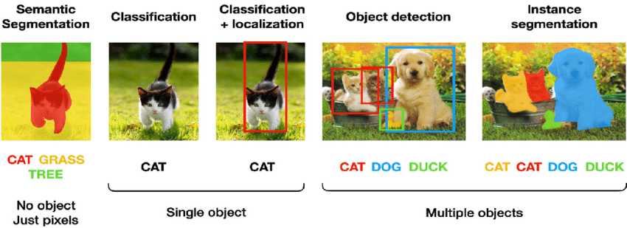
Computer Vision Subfields

Slide 33

Computer Vision :
Classification
5
Definition, Applications and Examples

Slide 34
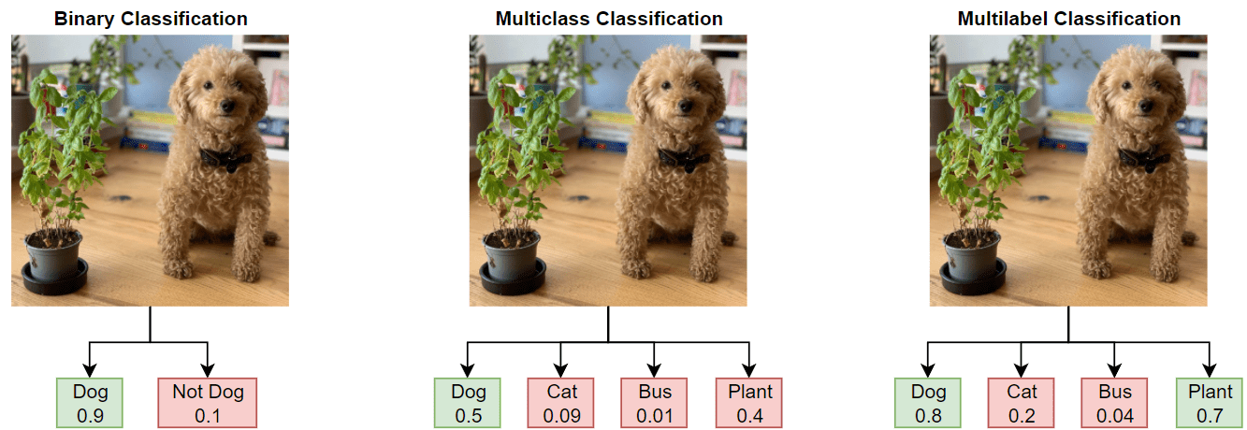
Classification Types
Single Object
Multiple Objects

Slide 35
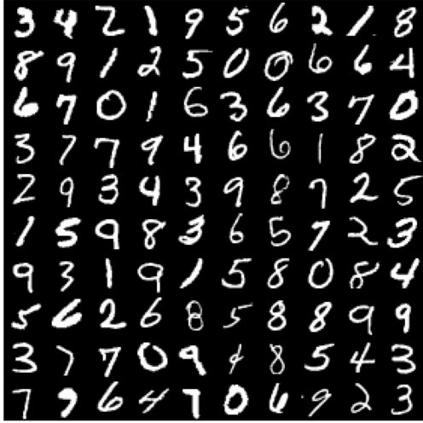
Classification Example

Slide 36
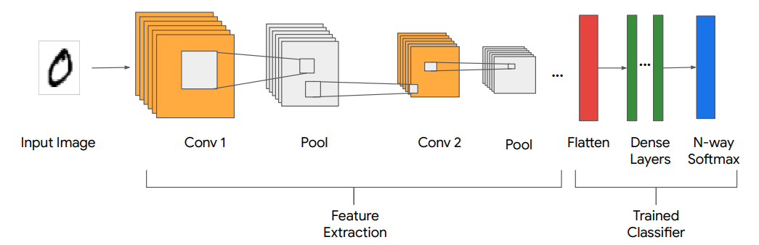
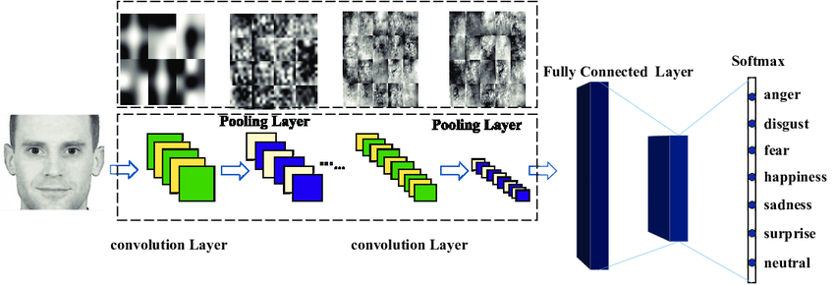
Classification
Model Example
1.Classifying MNIST GitHub

Slide 37
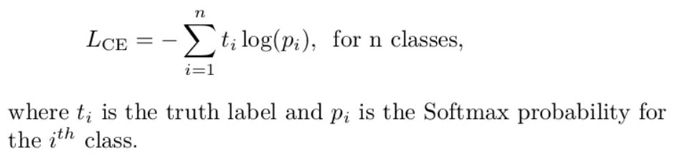
Classification Example Loss

Slide 38
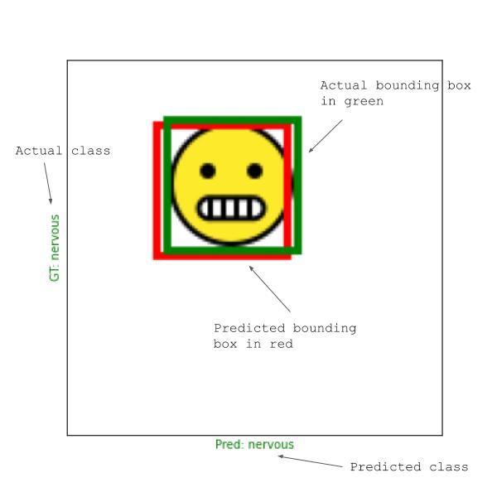
Computer Vision :
Localization
6
Definition, Applications and Examples

Slide 39
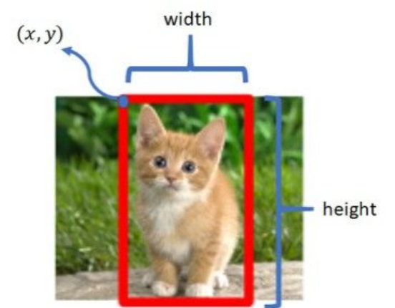
Localization

Slide 40
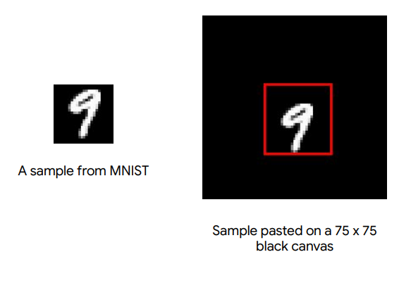
Localization Example

Slide 41
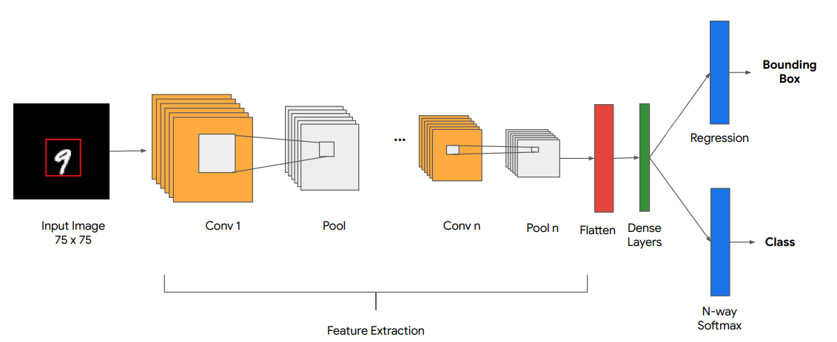
Localization Model Example

Slide 42
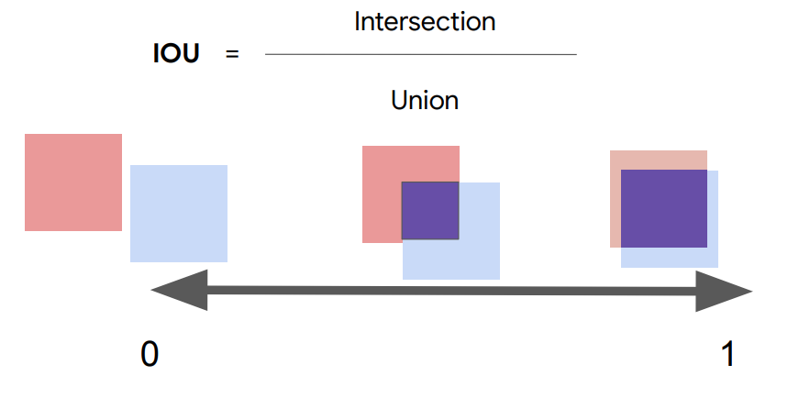
Localization Example Loss

Slide 43
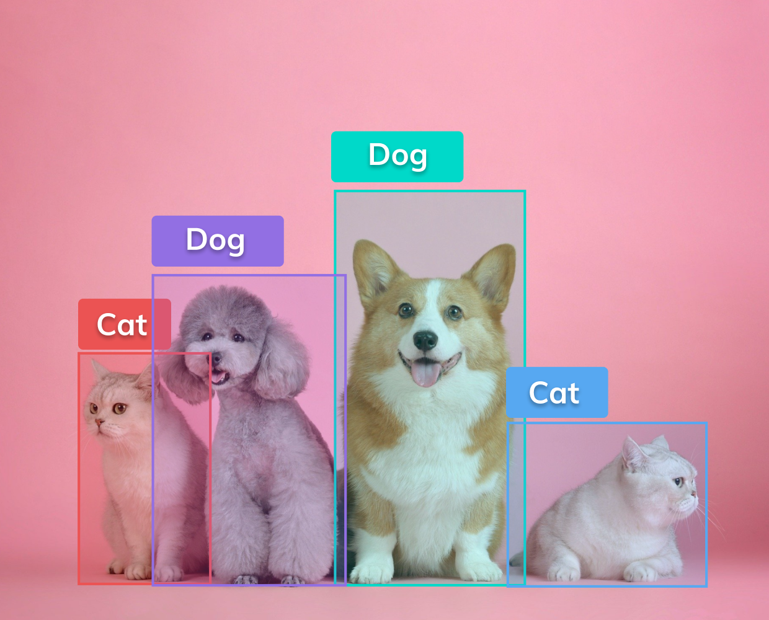
Computer Vision :
Object Detection
7
Definition, Applications and Examples

Slide 44
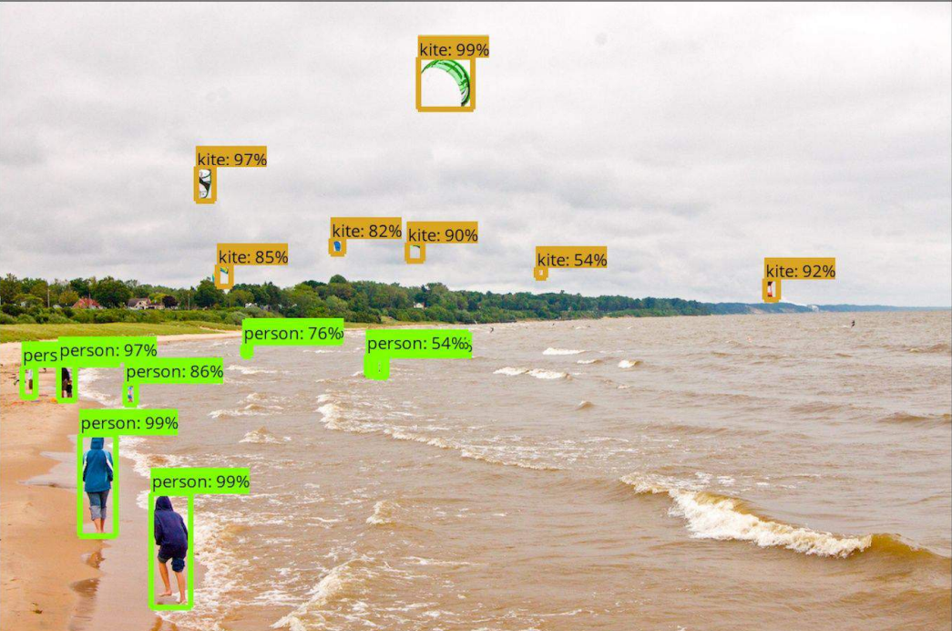
Object Detection

Slide 45
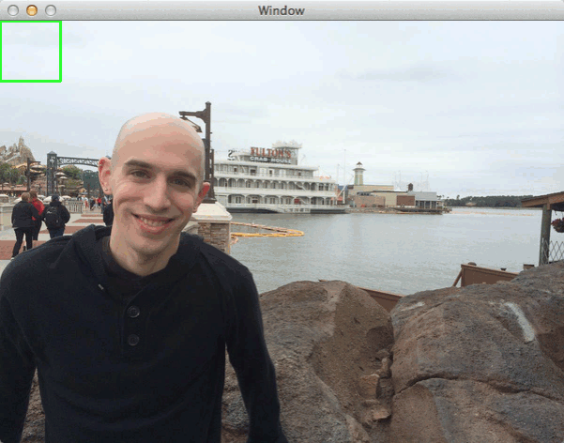
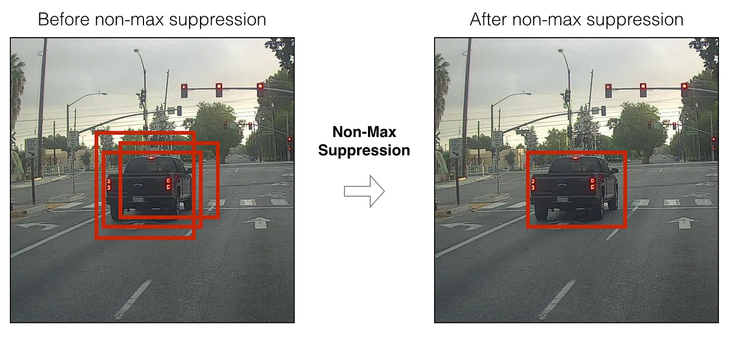
Object Detection Steps
Two phases :
Sliding Window & Non-Maximum Suppression
Object Detection & Classification

Slide 46

Object Detection Model Examples
YOLOV5 GitHub
SSD Paper

Slide 47

Computer Vision :
Segmentation
8
Definition, Applications and Examples

Slide 48

Segmentation Architecture

Slide 49

Semantic Segm. VS Instance Segm.

Slide 50

Semantic Segmentation Model Example
UNet Paper
Encoder
Decoder

Slide 51

Instance Segmentation Example Model

Slide 52

Segmentation Example Loss
Or

Slide 53



Workshop Presentation
9
Explanation of the workshop

Slide 54

TensorFlow
Google’s open-source library for machine learning

Slide 55






TensorFlow
Example
1
2
3
4
5
6
7
8
9
10

Slide 56

Workshop Subject
Classification problem
Model improvements
Data improvements
Model testing
Model exporting

Slide 57

Workshop
Relationships

Slide 58


Kaggle Contest
10
Contest subject & rules

Slide 59

Kaggle
Google’s platform for data science competitions

Slide 60

Contest Subject
Classification problem
Minecraft Biome Dataset
No transfer learning
Maximum 22 layers
Skeleton provided
Prizes will be announced
22nd June (in 1 week)
Competition Starts
2023
JUNE
JULY
20th July (in 5 weeks)
Competition Ends

Slide 61
Contest Tips
Use successive convolutions
Take a look at the architecture of VGG
Validation dataset is closest to reality
Data is very unbalanced
Don’t overfit too much !
Don’t forget to create your CSV submission during execution !
Inspire yourself from the workshop
Don’t hesitate to contact SCIA folks !

Slide 62

Did you notice ?
20% of the photo is computer generated !
(DALLE-2 from OpenAI)

Slide 63




THANKS!
Any questions?
You can find me at:
OrdinaryDev83
tom.genlis@gmail.com
Tom Genlis
OrdinaryDev83#9338

